Slide 1
SDA KPI Project Problem Statement Demo
Inner Source & Technical Solutions, July 2022
Notes:
Change the month on the slide

Slide 2
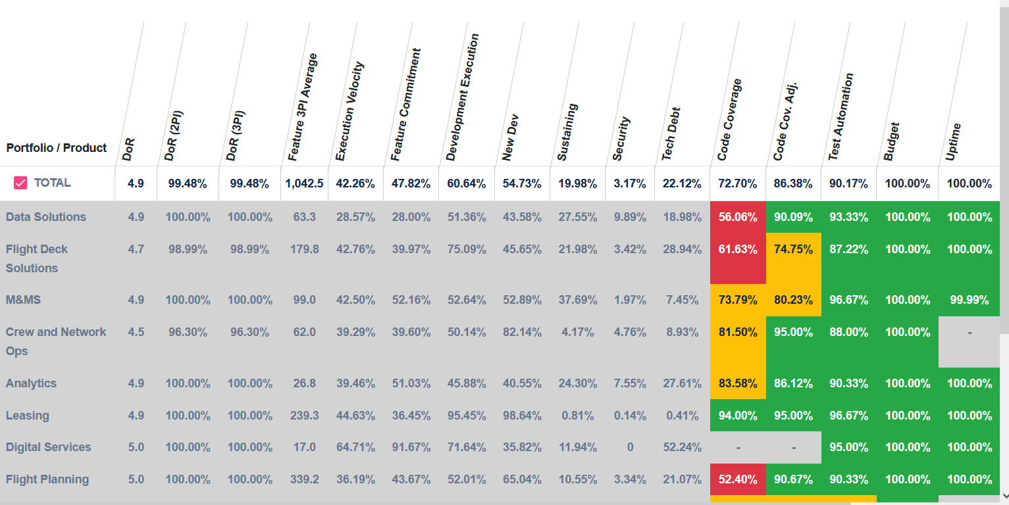

Problem Statement
The SDA KPI dashboard is used for Monitoring Performance of Multiple Portfolios/products periodically.
Currently existing SDA (Software Development & Analytics) KPI dashboard was built to replace the old spreadsheet dashboard which was used for tracking KPIs for the SDA organization.
The current application that was replaced exists in the AWS Jira environment.
Drawbacks of the current implementation is that users require special access to view and it also has some limitations based on the technology that was developed.
This challenge seeks to re-think how it is implemented and provide better flexibility to upgrade and ease user access.
Participants are expected to build an end-to-end application (Next Generation dashboard) which includes a web interface to edit the SDA KPI data in the web application by using any Boeing approved technologies.
Inputs to be provided for challenge:-
A sample of the original excel as well as visuals of the current application will be provided.
Additionally a metrics specification exists to give additional details for each of the current elements.
Jira Access URL and token
Next Generation Dashboard
Old Spreadsheet Dashboard
Existing Dashboard
New Dashboard

Slide 3
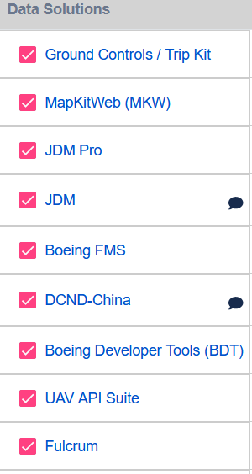
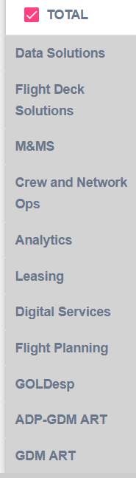
Problem Statement Explanation
All the KPI metrics should be entered / captured as a product level
Product
  Each and every Project called as a product
Portfolio
  Products grouped as a Portfolio
Overall
  Portfolio grouped as a Overall KPI
Rollup
Rollup
Overall KPI
Product
Portfolio

Slide 4
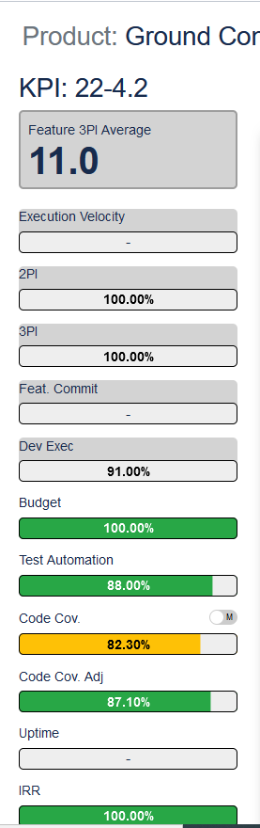
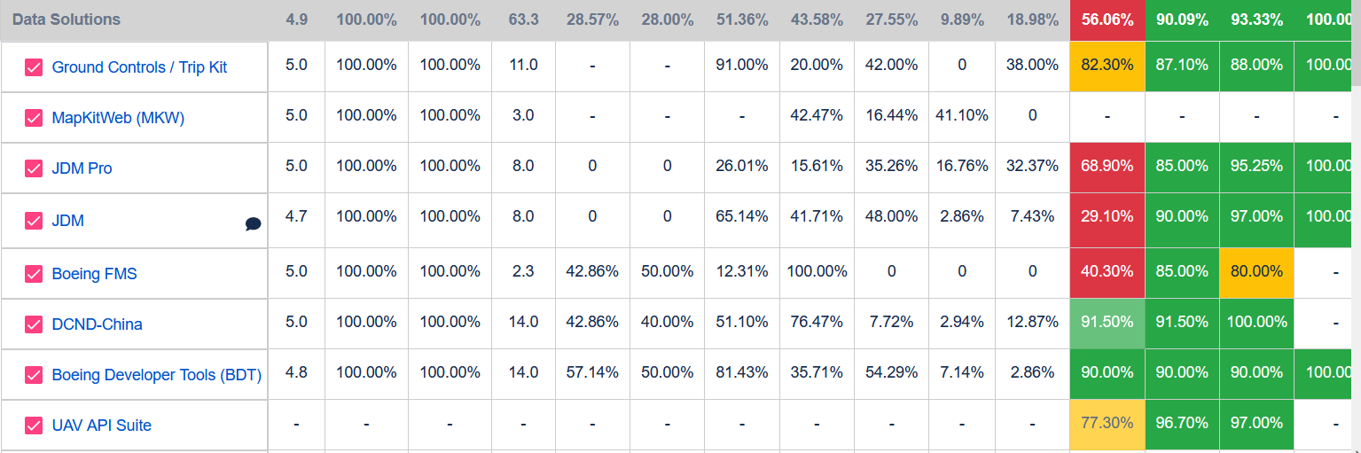
SDA KPI Dashboard
Rollup
Rollup
Overall KPI
Product
Portfolio

Slide 5
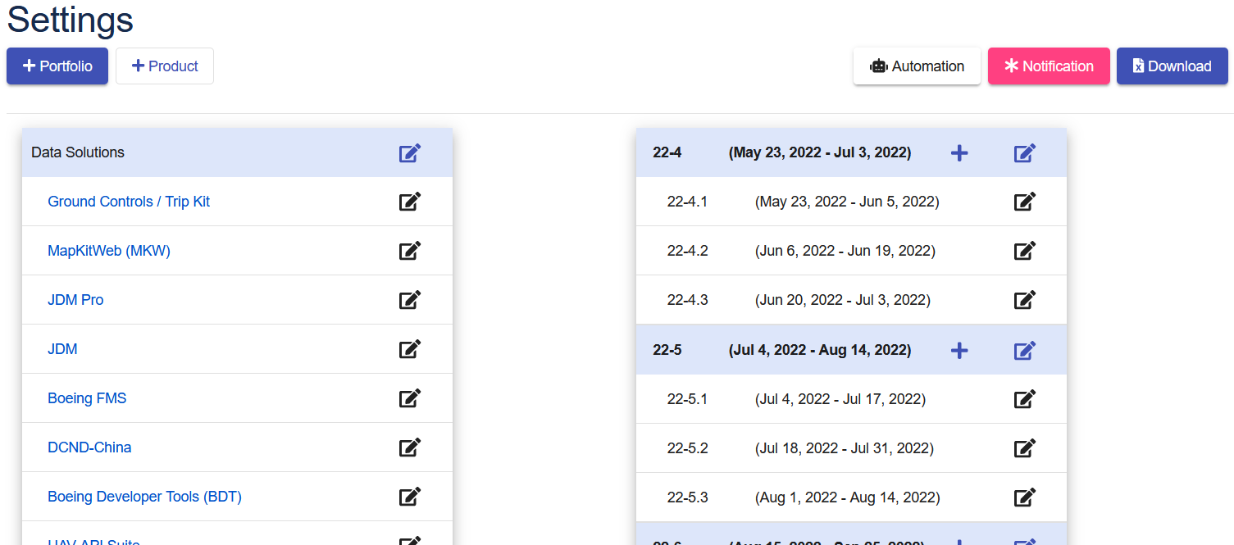
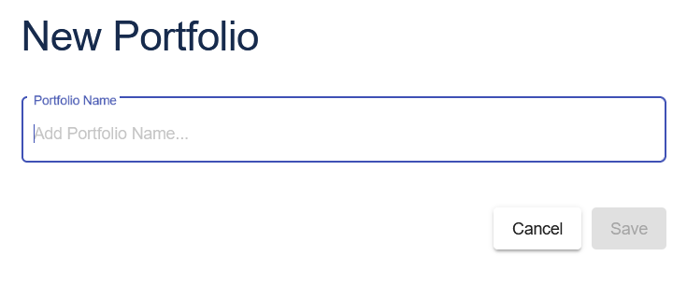
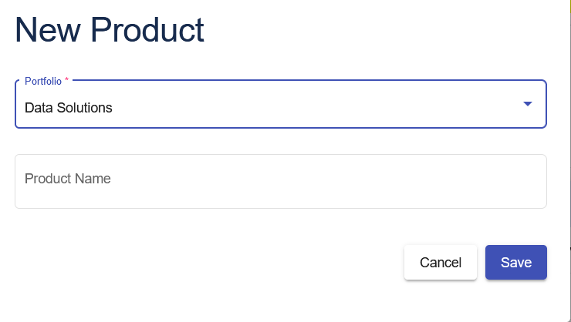
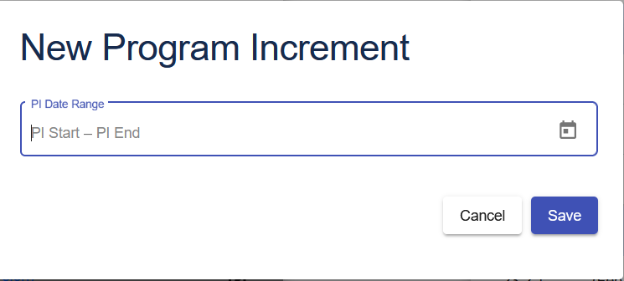
Admin Page

Slide 6
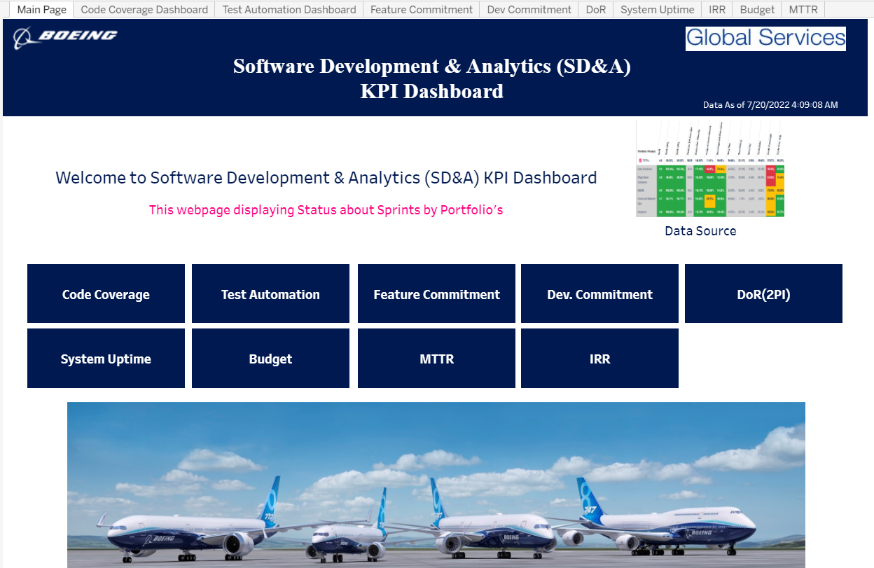
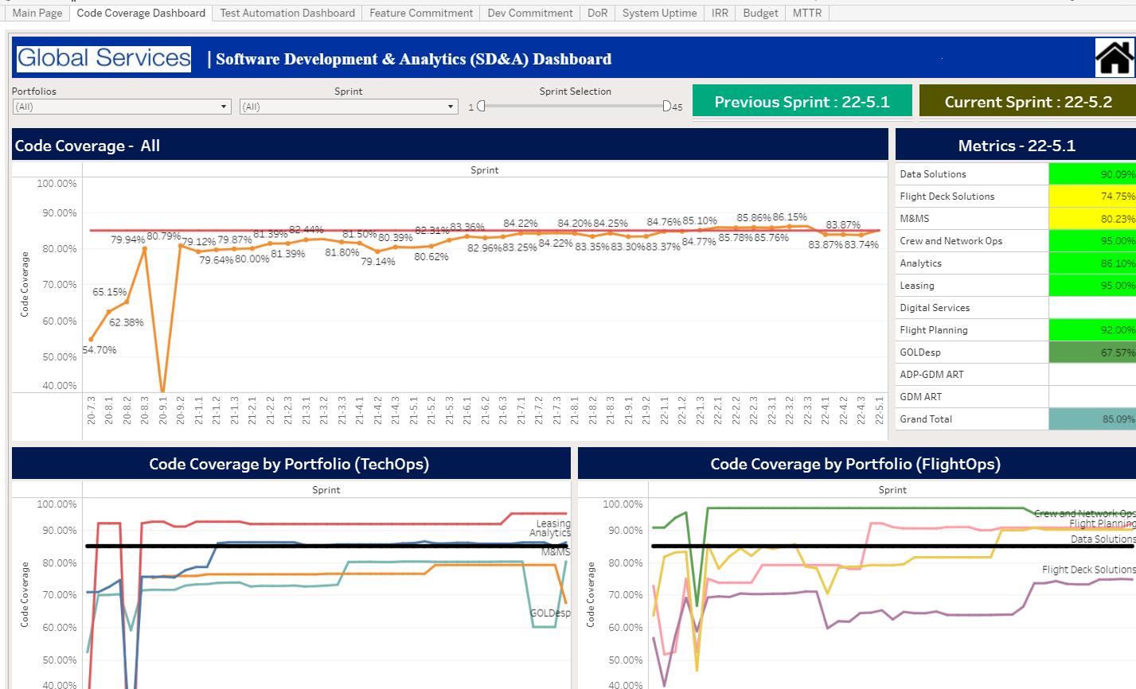
Data Visualizations

Slide 7
Product Level Details
Key KPIs:
Code Coverage, Test Automation, #Features (planned/completed), #User Stories, Uptime, MTTR
Some KPIs are Automation, others are manual entry.
E.g., Code Coverage from Sonarqube,
Features (planned/completed), #User Stories, from JIRA
Test Automation - Manual Entry
In this phase we are going to focus only on JIRA automation to the dashboard
As part of this contest, developed solution should interface with an existing JIRA instance (Jira URL & token for access would be provided) to pull the Jira related metrics

Slide 8
Technology Stack
Any RDBMS,
UI: Any Boeing approved software/tool/package.
Rest API.
Any Boeing approved software for visualizations (includes Boeing approved open source tools)

Slide 9


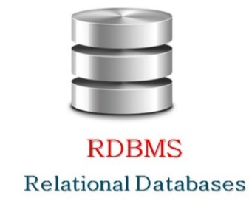
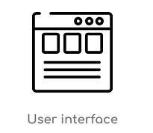
High Level Architecture
Data Available
URL and Authentication Token Fetch Data from Jira
Application Level Database
(UI should Allow to View, Edit and Change Data

Slide 10
Jira Access
URL:
https://test.dat.jeppesen.com/jiradev/rest/api/2/search?jql=project=IDDS&maxResults=2000
https://test.dat.jeppesen.com/jiradev/rest/api/2/search?jql=project=FPX&maxResults=2000
Token: ODU4NDAyNzgwODcwOpDJ8Xo2Mof9wcMrsbf+mp2gn+X0
Program Increment: PI creation to be done in Admin Page
                Each PI has 3 Sprints

Slide 11
Detailed view of Problem Statement

Slide 12
Key Points
1. Mapping columns from JIRA to UI should be Configurable against Product, because column name /column_id might vary for different environment
Example : customfield_10801 is mapped to Stories Planned in Test Instance. In Production it may be customfield_10051
2. Similarly keep all other necessary items configurable
3.Perform only Get operations using the API URL.

Slide 13
Acceptance Criteria:
Participants are expected to build an end-to-end application which includes a web interface to edit the SDA KPI data in the web application, create/manage required database objects for the SDA Dashboard, APIs and Data Visualization (Dashboard).
Manual entry for all fields will be allowed, even if automation exists, the user can override the value.
User permissions include user admins, users with access to update individual product information and read only users.
Each product is rolled up into a portfolio and each portfolio is rolled up into an overall KPI summary.
Data can be visualized by individual product metric or as a roll up at the portfolio or SDA summary
Admin has the ability to create custom date ranges for Program Increments and Sprints.
The solution provided should have a web interface to edit KPI data with following features
  Table or other appropriate data to display the content on a web browser
  Sorting, filtering and grouping on the columns
  Edit existing record(s)
  Add new record(s)
  Save changes to database
  Export data to spreadsheet
  Should be efficient in terms of performance and UX
  Solution should be capable of being integrated with a cloud offering like PCF (Note – The solution need not be hosted on any cloud platform by the participants as part of this activity. This can be optional Feature for this competition.
All DDL and DML changes should be scripted and be made available as part of source code.
Data Sync from Jira to RDBMS should be automated. (May not be implemented as part of this contest)
Solution should have the capability to be integrated with Single Sign on capabilities (SSO may not be implemented as part of this contest)

Slide 14
Guidelines
Participants who are registered for the contest would be given access to the Inner Source repository
Small demo video on existing functionality would be made available
Every participant have to create their own branch out of Master (‘Challenge_2_<BEMSID>’).
The solution developed should follow proper coding standards, code documentation, project structure and must be easy to maintain
Participants who have completed the challenge can check in the code along with scripts for the database creation/modification to their respective branches. Also, create a ‘demo’ folder and commit a video recording of the working solution/demo
Demo video can be created by running the application in local machine. Application should not hosted on any cloud platform
This is not a team activity. This challenge has to be taken up by individuals and worked
This is a stretch activity and no charge lines are available.
Solution should use only RDBMS database (Relational Database) technologies for database layer. Front-end and service layer technologies could be Angular, ReactJS, C#, .net Rest APIs, that best suits the requirement.
All software and libraries used should only be downloaded from the SRES or Software Express to ensure that the software used are Boeing approved. Software/libraries should not be downloaded or copied from the external sources.
Solution should only be worked on the Boeing laptop adhering to the Boeing InfoSec policies.
This challenge is expected to be completed in 6 weeks.

Slide 15
Communication Channel
Inner Source Mattermost channel is the platform for communications during the event period.
Winner Selection Process
Winners would be selected based on the following factors
    Meeting the acceptance criteria
    Solution should be robust and easily scalable for future need with minimal effort
    Following basic coding standards and code documentation
    Adhering to all the process and InfoSec related guidelines
Winner would be recognized with an exciting reward and winner’s name on ‘Star Coders’ wall of fame

